Slide 1
Non negotiables of Church Life Acts 2:42-47

Slide 2
Non negotiables of Church Life Acts 2:42-47
Evangelise

Slide 3
Non negotiables of Church Life Acts 2:42-47
Exalt
Evangelise

Slide 4
Non negotiables of Church Life Acts 2:42-47
Exalt
Evangelise
Encourage

Slide 5
Encourage one another through fellowship
^{Acts 2:42-47} They devoted themselves to the apostles’ teaching and to the fellowship, to the breaking of bread and to prayer. Everyone was filled with awe, and many wonders and miraculous signs were done by the apostles. All the believers were together and had everything in common. Selling their possessions and goods, they gave to anyone as he had need. Every day they continued to meet together in the temple courts. They broke bread in their homes and ate together with glad and sincere hearts, praising God and enjoying the favour of all the people. And the Lord added to their number daily those who were being saved.
Encourage - give support, persuade with advice, stimulate beliefs

Slide 6
Encourage one another through fellowship
^{Acts 2:42-47} They devoted themselves to the apostles’ teaching and to the fellowship, to the breaking of bread and to prayer. Everyone was filled with awe, and many wonders and miraculous signs were done by the apostles. All the believers were together and had everything in common. Selling their possessions and goods, they gave to anyone as he had need. Every day they continued to meet together in the temple courts. They broke bread in their homes and ate together with glad and sincere hearts, praising God and enjoying the favour of all the people. And the Lord added to their number daily those who were being saved.
Encourage - give support, persuade with advice, stimulate beliefs

Slide 7
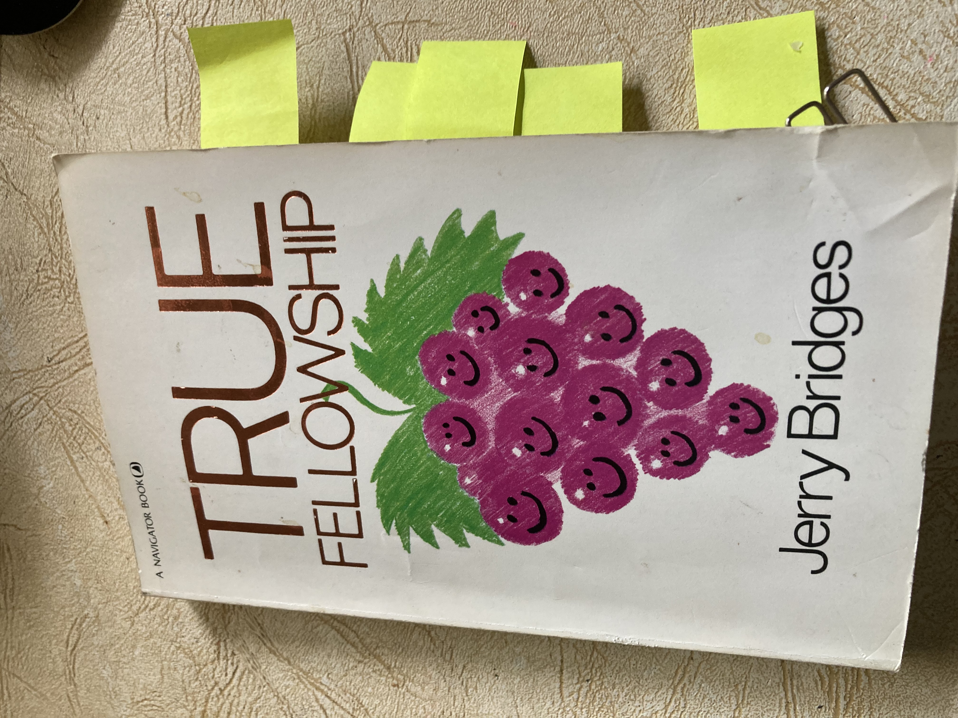
Encourage one another through fellowship
Jerry Bridges in his book True Fellowship… writes
Our understanding of fellowship falls far short of what God
has provided for us. True fellowship is not Christian
social interaction. Nor is it confined to spiritual activities…
group prayer, Bible study and sharing what God is doing in your life-
important as these things are.
“Fellowship is not an activity: it is a relationship.”
Fellowship – not an activity it is a relationship

Slide 8
Encourage one another through fellowship
^{Acts 2:42-47} They devoted themselves to the apostles’ teaching and to the fellowship, to the breaking of bread and to prayer. Everyone was filled with awe, and many wonders and miraculous signs were done by the apostles. All the believers were together and had everything in common. Selling their possessions and goods, they gave to anyone as he had need. Every day they continued to meet together in the temple courts. They broke bread in their homes and ate together with glad and sincere hearts, praising God and enjoying the favour of all the people. And the Lord added to their number daily those who were being saved.
Fellowship – not an activity it is a relationship

Slide 9
Encourage one another through fellowship
^{Acts 2:42-47} They devoted themselves to the apostles’ teaching and to the fellowship, to the breaking of bread and to prayer. Everyone was filled with awe, and many wonders and miraculous signs were done by the apostles. All the believers were together and had everything in common. Selling their possessions and goods, they gave to anyone as he had need. Every day they continued to meet together in the temple courts. They broke bread in their homes and ate together with glad and sincere hearts, praising God and enjoying the favour of all the people. And the Lord added to their number daily those who were being saved.
End result

Slide 10
Koinonia - Greek word for Fellowship
To share together in the sense of joint participation or partnership
To share with in the sense of giving what we have to others

Slide 11
Koinonia - Greek word for Fellowship
To share together in the sense of joint participation or partnership
To share with in the sense of giving what we have to others

Slide 12
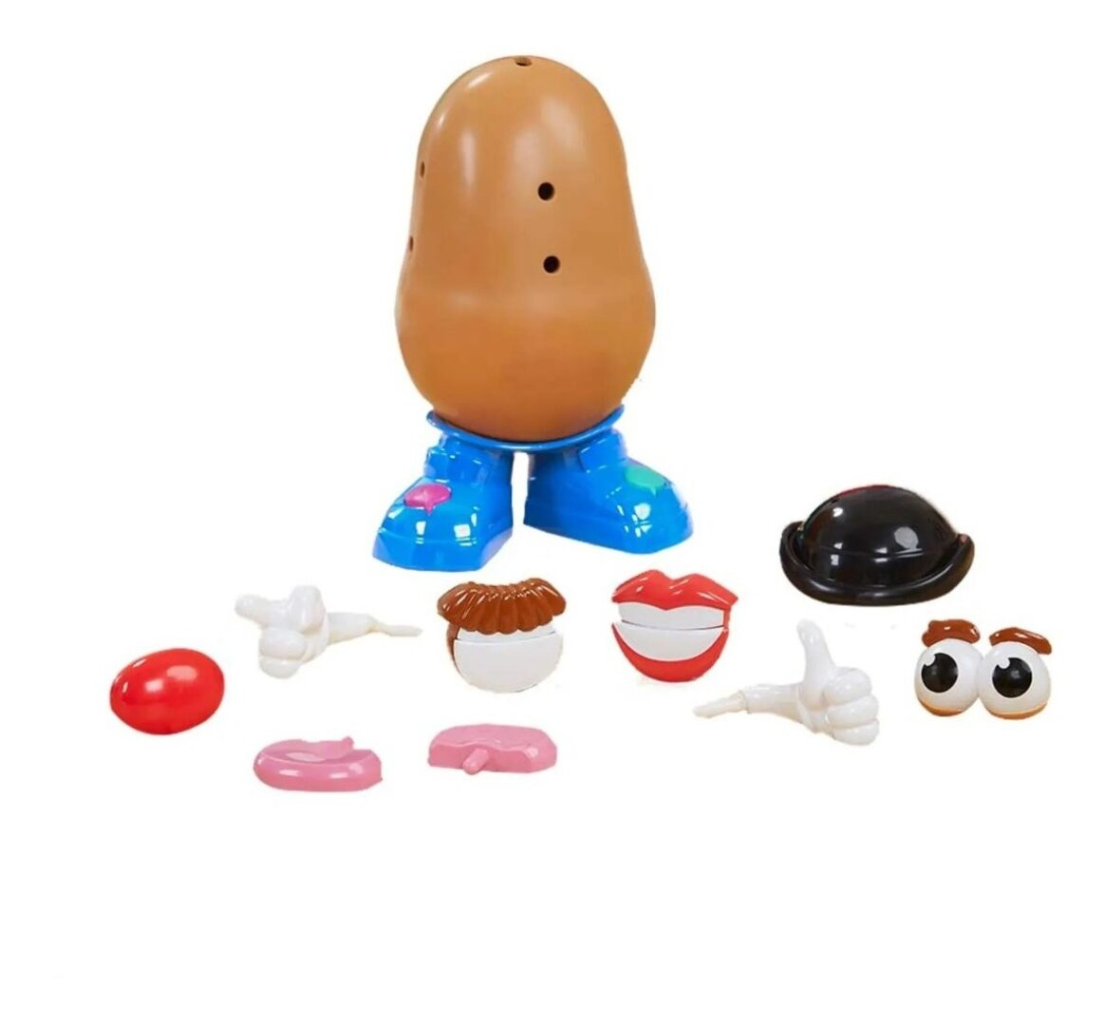
1 Corinthians 12:12-27
One body - many parts
God has arranged the parts in the body
Every part is valuable
No division - equal concern for each other
One part suffers, we all suffer
One part is honoured, we all rejoice

Slide 13
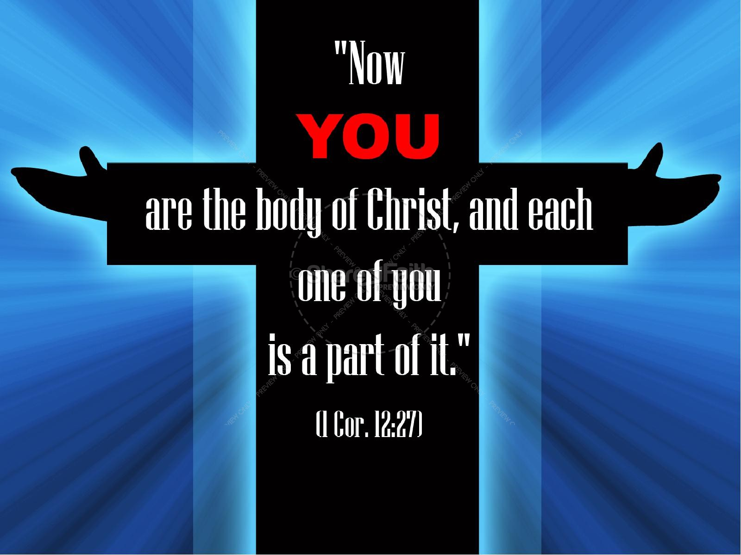
Encourage one another through fellowship

Slide 14
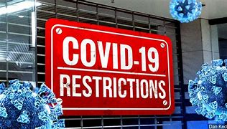
15
Km
only

Slide 15
Encourage one another through fellowship
Relationship

Slide 16
Encourage one another through fellowship
Relationship
Community impacting

